Slide 1
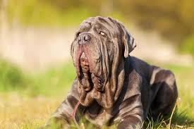
Welcome To Pet Pose
Instagram for pets

Slide 2
Pet Pose Overall Beginning Concept
A site to allow users to:
Post Pictures of their furry family member.
Comment on other users post
Like post and comments
Notes:
Shannon

Slide 3
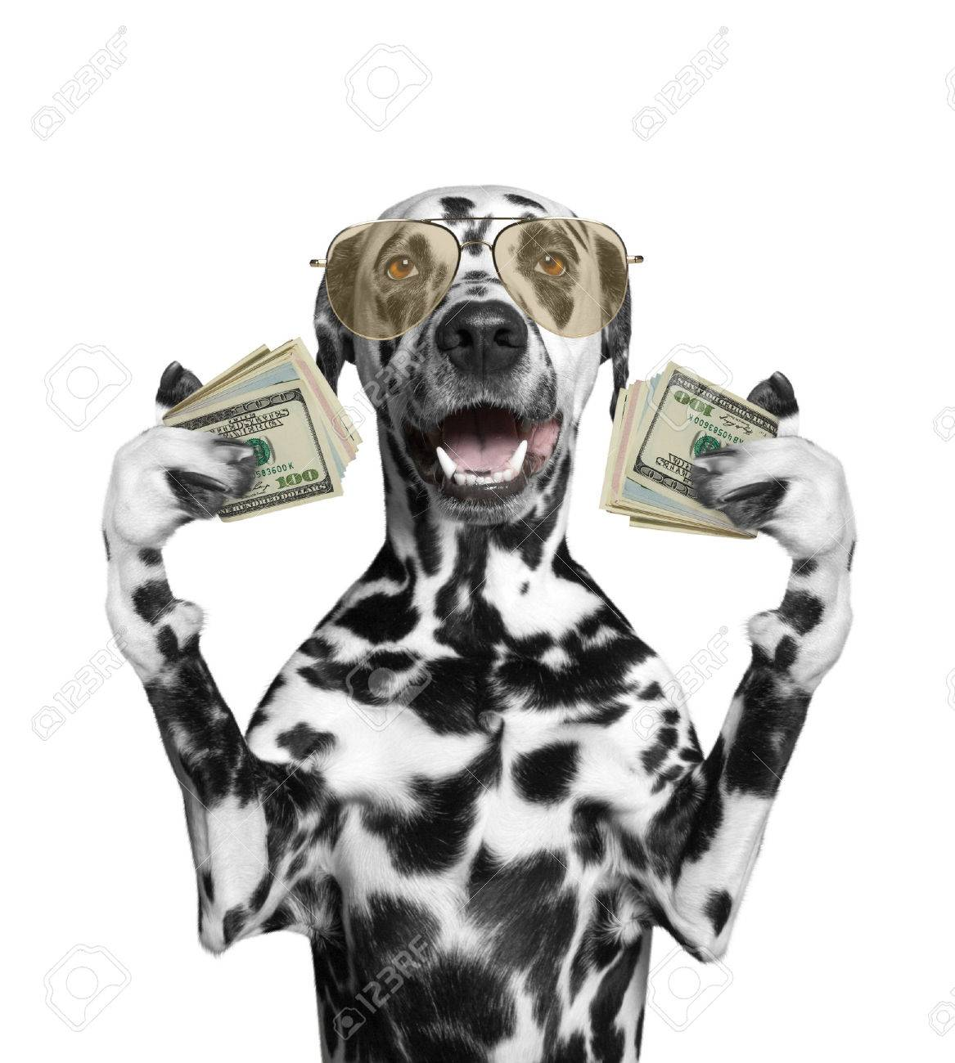
Pet Pose Motivation
Fans are able to share and read these stories and theories online.
Notes:
Shannon

Slide 4
Design Process
Github repository created, came up with a team process (Standard Operating Procedure) for utilizing github.
Framework sketched (see next slide)
Talked through psuedocode.
Researched similar sites and combined the ideas from our favorites.
Mongo DB database built
Queries and code written.
CSS and HTML front end styled.
Connect Front End to Back End.
Debugged front end to show the site visually as intended.
Collaborated on connections and routes.
Researched APIs.
Notes:
Jeffery

Slide 5
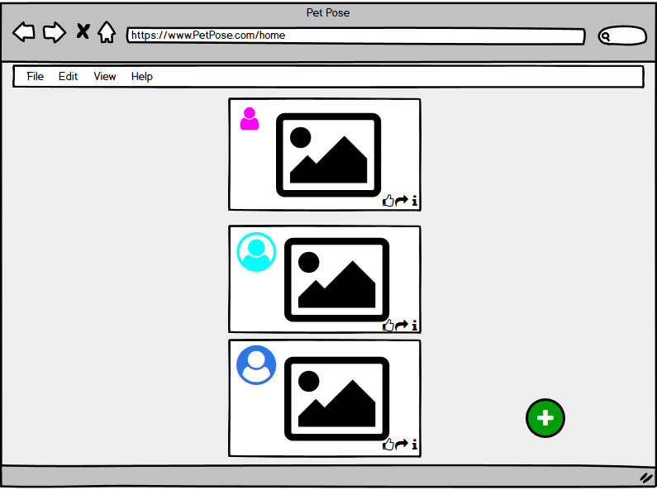
Original mock-up
Notes:
Jeffery

Slide 6
Project Plan
GitHub version management and design- Orlando
Heroku deployment
Polished front-end/UI
Node & Express Web Server
Mongo DB
GET and POST routes
New library, package or technology
MERN appilication structure
APIs
Debugging/Testing
Project management
Notes:
Orlando

Slide 7
Technology used and how it works
Mongo DB
CSS, Bootstrap
JSON
Javascript
Node, Express
HTML
Github
Heroku
New technology:
ReactStrap
Material UI
Concurrently
Notes:
Orlando

Slide 8

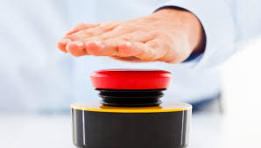



APP DEMO
Notes:
Aaron

Slide 9
Future development
Adding an API to connect random pet pictures to display in a component
Add comments functionality
Add notifications to show when users online, post new comment/video etc.
Utilize Materialize
Image support
Sorting the feed by newest post
Notes:
Aaron

